Slide 1
Randomized algorithms 3 Chernoff Bounds
CS240 Spring 2024
Rui Fan

Slide 2
Beating expectations
Given a random variable X, the expected value E[X] is the value we’re “supposed” to get when we take a sample of X.
Of course, we won’t always get E[X].
But what is the probability the sample is very different from E[X]?
Ex If we flip a fair coin 100 times, we expect to get 50 heads. What’s the probability we get 60 heads? 80 heads? 100 heads?

Slide 3
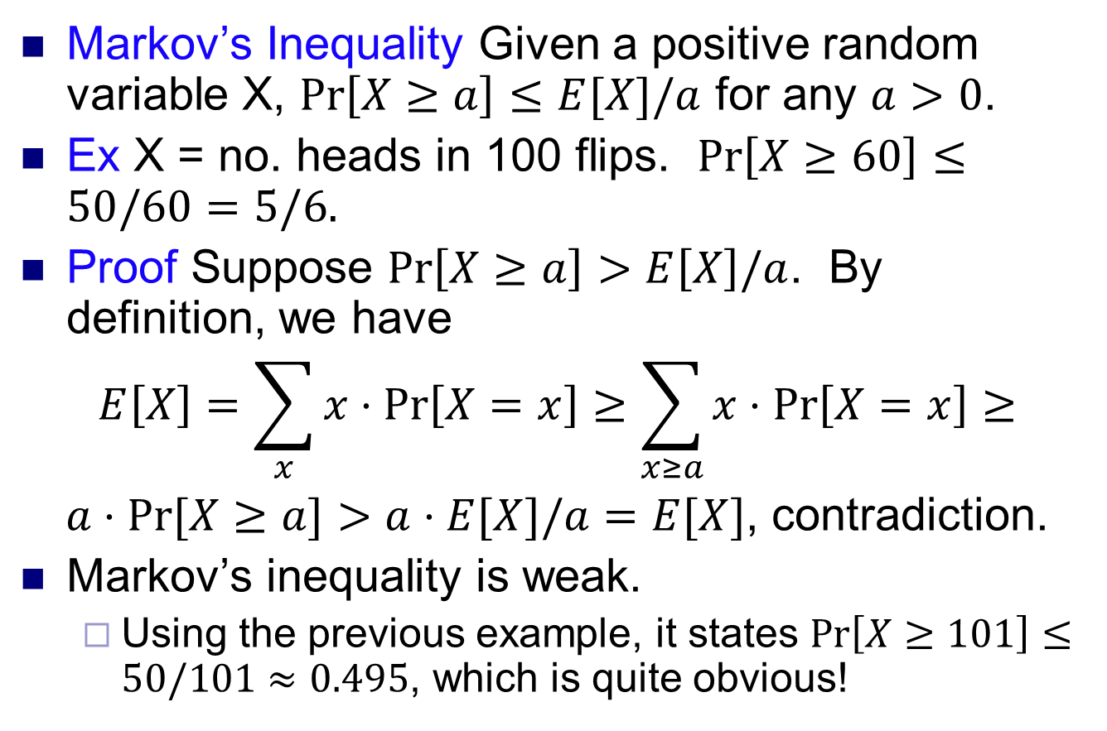
Beating expectations
Markov’s Inequality Given a positive random variable X, $\operatorname{Pr}\left[X≥a\right]≤E[X]/a$ for any $a>0$.
Ex X = no. heads in 100 flips. $\operatorname{Pr}\left[X≥60\right]≤50/60=5/6.$
Proof Suppose $\operatorname{Pr}\left[X≥a\right]>E\left[X\right]/a$. By definition, we have
$$E\left[X\right]=\sum_{x}{x⋅\operatorname{Pr}\left[X=x\right]≥\sum_{x≥a}{x⋅\operatorname{Pr}\left[X=x\right]≥}}$$
$a⋅Pr⁡[X≥a]>a⋅E[X]/a=E[X]$, contradiction.
Markov’s inequality is weak.
Using the previous example, it states $\operatorname{Pr}\left[X≥101\right]≤50/101≈0.495$, which is quite obvious!

Slide 4
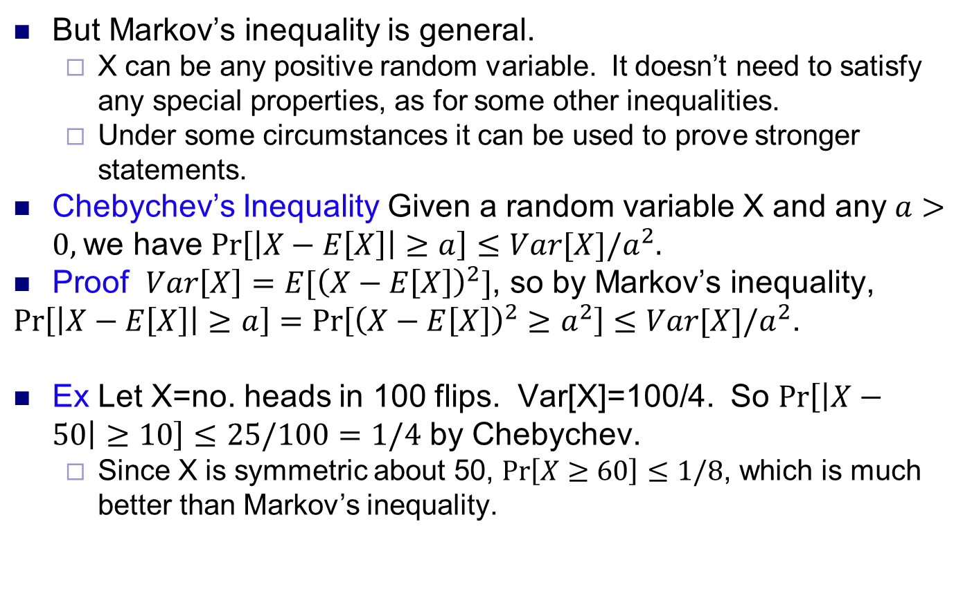
Beating expectations
But Markov’s inequality is general.
X can be any positive random variable. It doesn’t need to satisfy any special properties, as for some other inequalities.
Under some circumstances it can be used to prove stronger statements.
Chebychev’s Inequality Given a random variable X and any $a>0,$ we have $\operatorname{Pr}\left[\left|X−E\left[X\right]\right|≥a\right]≤Var[X]/a^{2}.$
Proof $Var\left[X\right]=E[{\left(X−E\left[X\right]\right)}^{2}]$, so by Markov’s inequality,
$\operatorname{Pr}\left[\left|X−E\left[X\right]\right|≥a\right]=\operatorname{Pr}\left[{\left(X−E\left[X\right]\right)}^{2}≥a^{2}\right]≤Var[X]/a^{2}$.
Ex Let X=no. heads in 100 flips. Var[X]=100/4. So $\operatorname{Pr}\left[\left|X−50\right|≥10\right]≤25/100=1/4$ by Chebychev.
Since X is symmetric about 50, $\operatorname{Pr}\left[X≥60\right]≤1/8$, which is much better than Markov’s inequality.

Slide 5
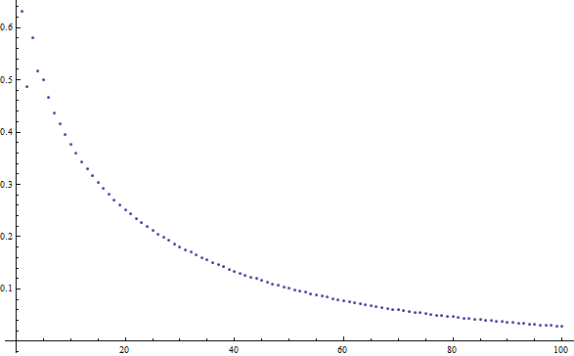
Sum of independent r.v.’s
We’ll consider a special kind of random variable X that is the sum of n independent random variables, for some n. We look at how likely X is to deviate from its expectation.
Intuitively, as n gets larger, X should approach E[X], in relative terms, very quickly.
In fact, the convergence is exponential.
Consider flipping a fair coin n times. What’s the probability we get at least 60% heads?
For n=10, the probability is 37.7%.
For n=20, the probability is 25.2%.
For n=30, the probability is 18.1%.
For n=40, the probability is 13.4%.
For n=100, the probability is 2.84%.

Slide 6
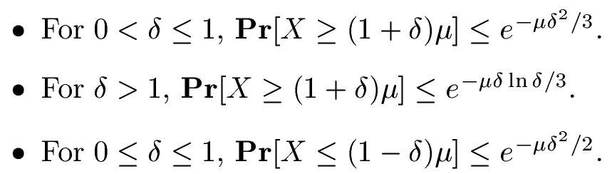
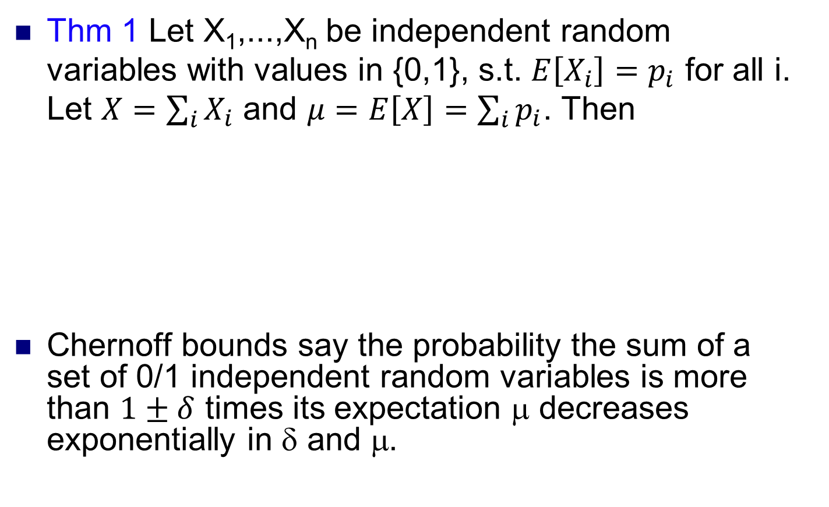
Chernoff bounds
Thm 1 Let X₁,...,X_{n} be independent random variables with values in {0,1}, s.t. $E\left[X_{i}\right]=p_{i}$ for all i. Let $X=\sum_{i}{X_{i}}$ and $μ=E\left[X\right]=\sum_{i}{p_{i}}$. Then
Chernoff bounds say the probability the sum of a set of 0/1 independent random variables is more than $1±δ$ times its expectation μ decreases exponentially in δ and μ.

Slide 7
Chernoff bounds
Chernoff bounds are very useful in the analysis of randomized algorithms.
Often the algorithm does things in independent stages.
It’s often easy to compute the expected cost of each stage.
The total cost is the sum of the cost of all the stages.
We use Chernoff bounds to show this is unlikely to be too big or small compared to its expectation.
There are some variants of Chernoff’s bound that differ in the precise bounds. Some giver tighter bounds for certain values of δ. Pick the best one to use for the situation.

Slide 8
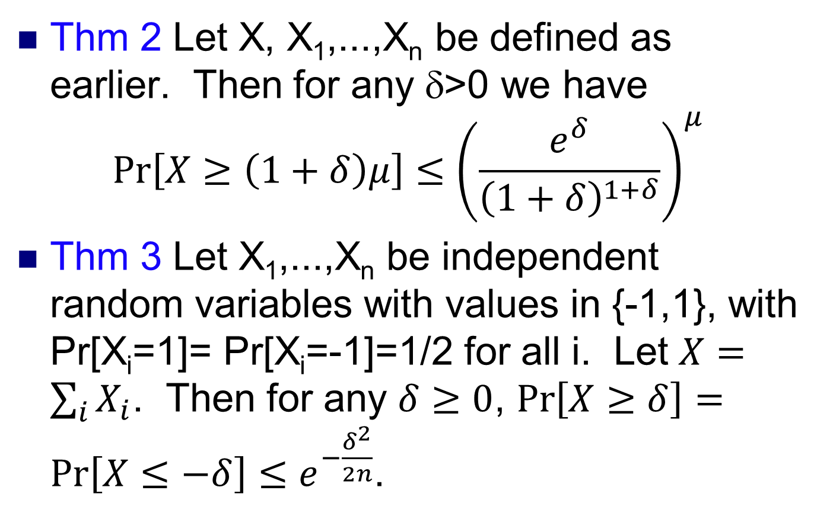
Chernoff bounds
Thm 2 Let X, X₁,...,X_{n} be defined as earlier. Then for any δ>0 we have
$$\operatorname{Pr}\left[X≥\left(1+δ\right)μ\right]≤{\left(\frac{e^{δ}}{{\left(1+δ\right)}^{1+δ}}\right)}^{μ}$$
Thm 3 Let X₁,...,X_{n} be independent random variables with values in {-1,1}, with Pr[X_{i}=1]= Pr[X_{i}=-1]=1/2 for all i. Let $X=\sum_{i}{X_{i}}$. Then for any $δ≥0$, $\operatorname{Pr}\left[X≥δ\right]=\operatorname{Pr}\left[X≤−δ\right]≤e^{−\frac{δ^{2}}{2n}}$.

Slide 9
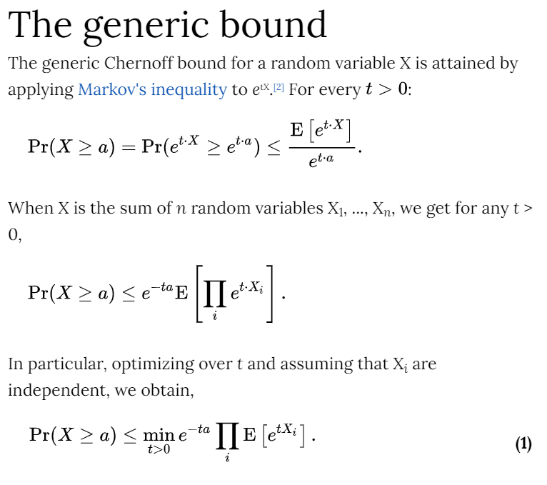
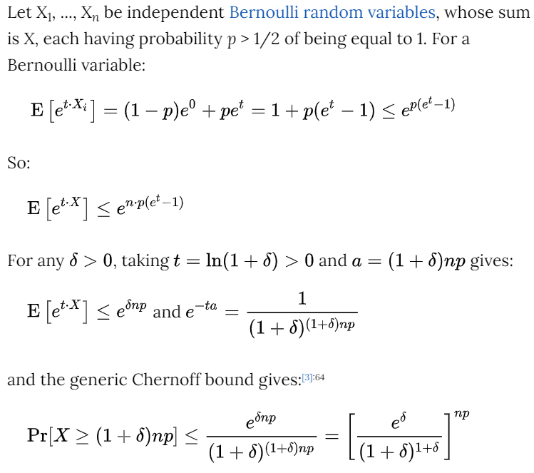
Proof of (simplified) Thm 2
Source: https://en.wikipedia.org/wiki/Chernoff_bound

Slide 10
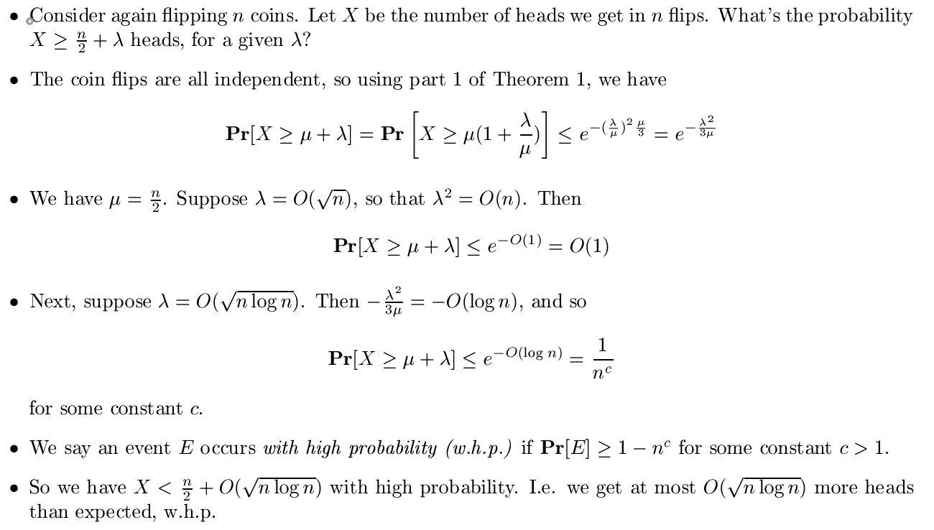

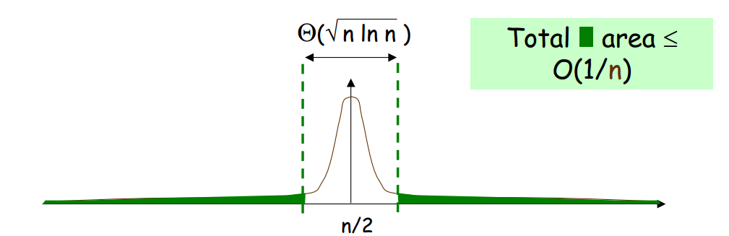
Coin flipping

Slide 11
Load balancing
Suppose we have n computers. A set of equal sized jobs arrive online. We need to assign each to a computer for processing.
To make all jobs finish fast, we want to give all computers (almost) same number of jobs. I.e. we want to balance their load.
A simple way is to assign jobs round-robin. Keep giving next job to next computer, wrapping around if necessary.
But this requires communicating with a centralized controller, which can be a bottleneck for large n.
Instead, we do randomized load balancing.
Algorithm Given a new job, assign it to a random computer.

Slide 12
Load balancing
How well does this balance the load?
If there are m jobs, then in expectation every computer gets m/n jobs.
Let X_{i} be the number of jobs computer i gets, and let X=max_{i} {X_{i}} be max number of jobs any computer gets.
We’ll bound probability that X_{i} or X are too large compared to the expectation m/n.
This shows the load is roughly balanced with high probability.
Let Y_{ij} be a random variable that’s 1 if the j’th job is assigned to computer i, and 0 otherwise.
Pr[Y_{ij} =1]=1/n, since the jobs are assigned randomly.
X_{i} =Σ_{j} Y_{ij} is the number of jobs i gets.
X_{i} is the sum of independent random variables Y_{ij}, so we can apply the Chernoff bound to X_{i}.

Slide 13
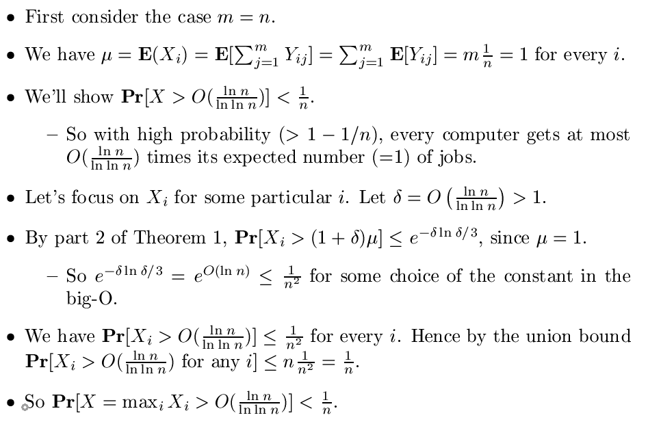
Analysis

Slide 14
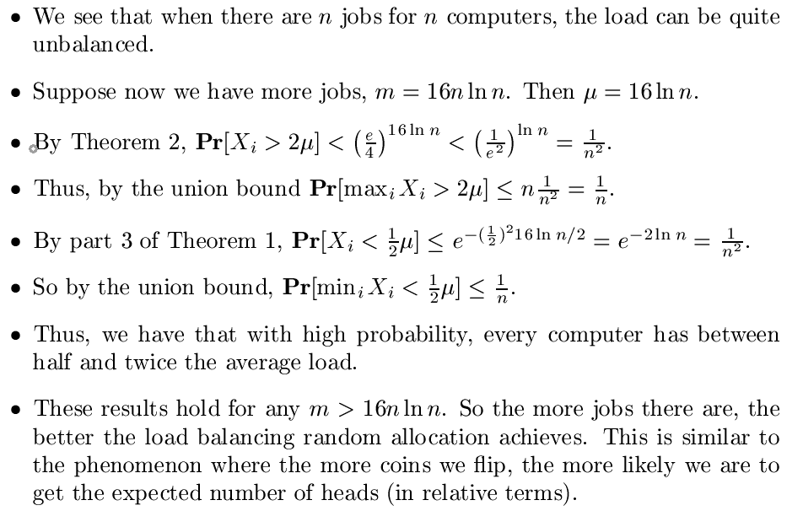
Analysis

Slide 15
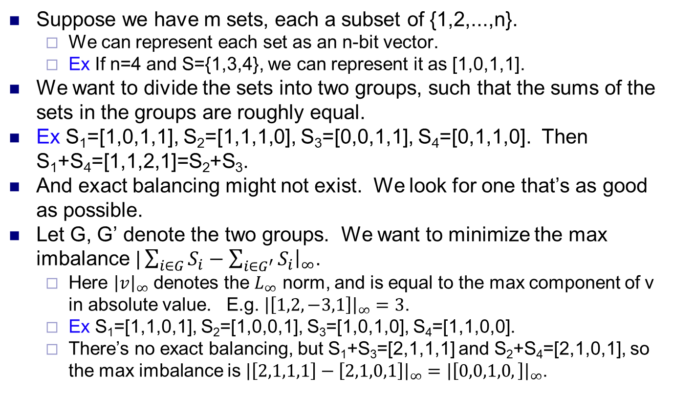
Set balancing
Suppose we have m sets, each a subset of {1,2,...,n}.
We can represent each set as an n-bit vector.
Ex If n=4 and S={1,3,4}, we can represent it as [1,0,1,1].
We want to divide the sets into two groups, such that the sums of the sets in the groups are roughly equal.
Ex S₁=[1,0,1,1], S₂=[1,1,1,0], S₃=[0,0,1,1], S₄=[0,1,1,0]. Then S₁+S₄=[1,1,2,1]=S₂+S₃.
And exact balancing might not exist. We look for one that’s as good as possible.
Let G, G’ denote the two groups. We want to minimize the max imbalance $|\sum_{i∈G}{S_{i}−\sum_{i∈G^{′}}{S_{i}{\left.​\right|}_{∞}}}$.
Here ${\left|v\right|}_{∞}$ denotes the $L_{∞}$ norm, and is equal to the max component of v in absolute value. E.g. ${\left|\left[1,2,−3,1\right]\right|}_{∞}=3$.
Ex S₁=[1,1,0,1], S₂=[1,0,0,1], S₃=[1,0,1,0], S₄=[1,1,0,0].
There’s no exact balancing, but S₁+S₃=[2,1,1,1] and S₂+S₄=[2,1,0,1], so the max imbalance is ${\left|\left[2,1,1,1\right]−\left[2,1,0,1\right]\right|}_{∞}={\left|\left[0,0,1,0,\right]\right|}_{∞}$.

Slide 16
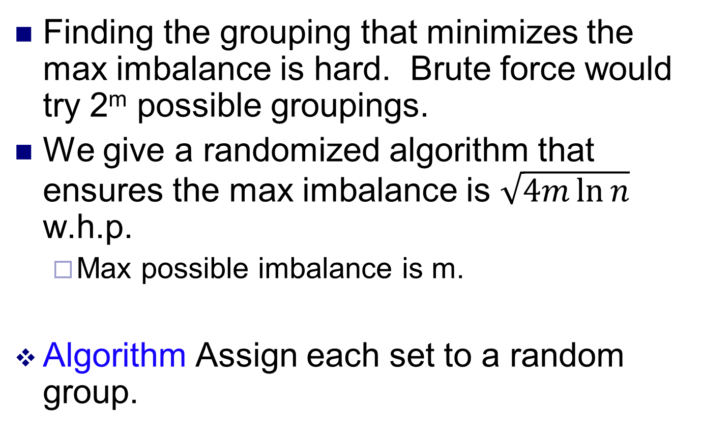
Set balancing
Finding the grouping that minimizes the max imbalance is hard. Brute force would try 2^{m} possible groupings.
We give a randomized algorithm that ensures the max imbalance is $\sqrt{4m\ln{n}}$ w.h.p.
Max possible imbalance is m.
Algorithm Assign each set to a random group.

Slide 17
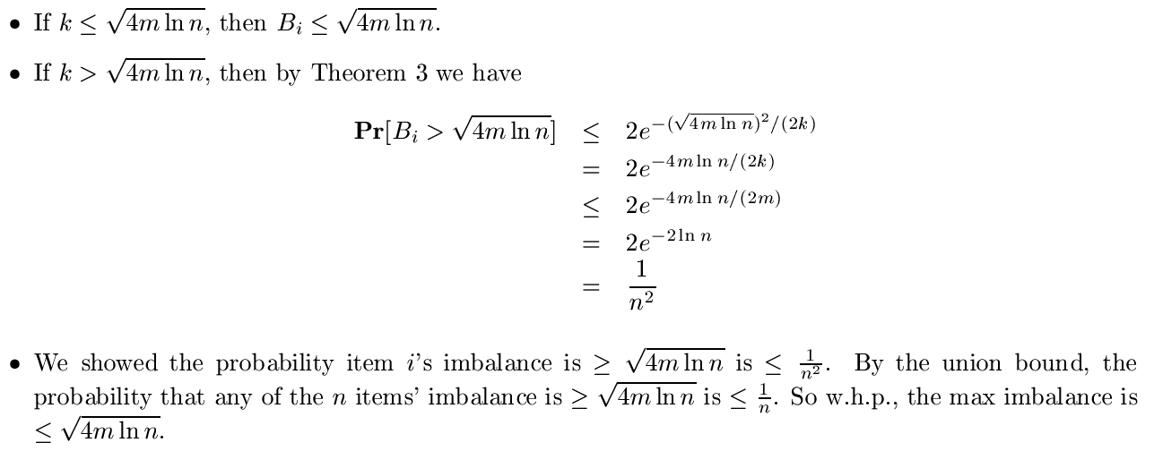
Analysis
Consider an item i. Suppose i belongs to k different sets.
For the j’th such set S, define X_{j}=1 if S is in the first group, and X_{j}=-1 if it’s in the other group.
The imbalance from item i is simply B_{i}=Σ^{k}_{j=1} X_{j}.
Since sets are assigned randomly, X₁,...,X_{k} are independent {1,-1} valued r.v.’s, we can apply Thm 3 to bound max_{i} B_{i}.

